Slide 1



IBM Cognos Analytics Solving Retail Demand Forecasting Challenges
Bi Solution Report
Sharon, Selena, Charmy & Lekhya
ISM6255

Slide 2
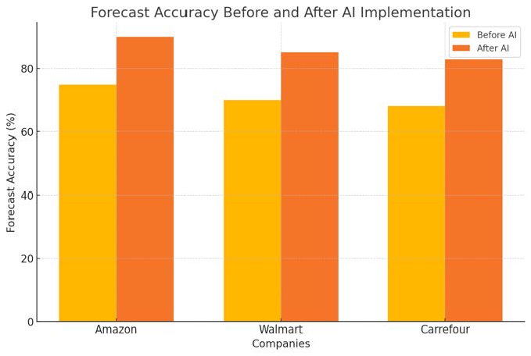
Why Better BI Matters in Retail
Forecast errors: up to 30% monthly, 9% quarterly
Leads to overstocks (markdown losses) & stockouts (lost sales)
Caused by: data silos, manual reports, low analytics access
Bullwhip effect amplifies inventory swings
BI helps unify data, predict trends, and enable fast decisions
McKinsey: 50% fewer inventory errors, 3–5% sales boost from AI analytics

Slide 3
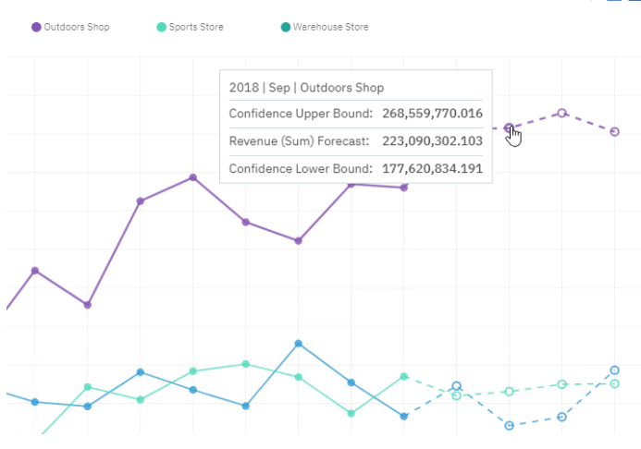
How IBM Cognos Solves the Problem
Predictive models improve demand accuracy
AI Assistant: Natural language queries for fast, self-service insights
Smart Discovery: Finds trends, anomalies automatically
Unifies data sources (POS, CRM, ERP)
Case Study: 33% forecast error reduction → €170M saved
ROI: 77% in 3 years; $1.1M efficiency gains (IBM, 2022)

Slide 4

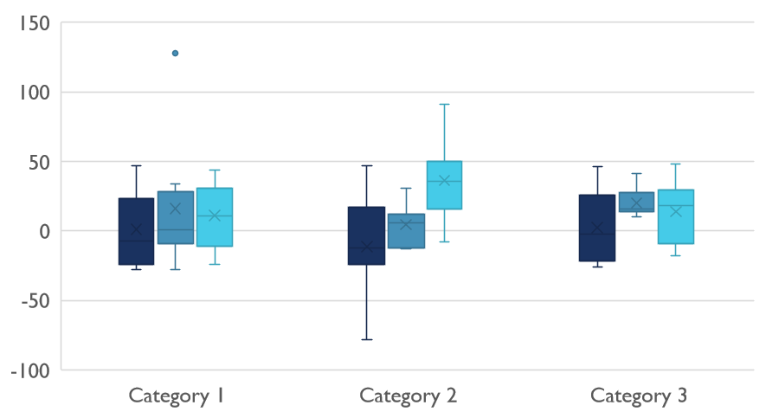
Competitive Landscape

Slide 5

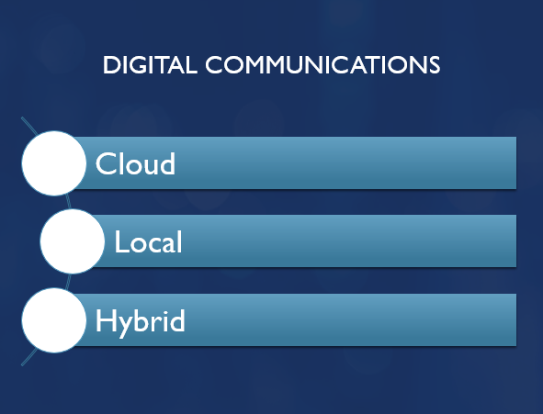

Slide 6

Dashboard & Data Visualization Tools

Slide 7

Dashboard & Data Visualization Tools
Dashboards are a core BI feature for rapid decision-making
Quickly interpret complex data
Improve accuracy & efficiency of decisions
Analytics-driven companies achieve better results
1.5× more likely to see above-average growth
5% higher return on sales (Hjelle et al., 2024)
Visualization tools deliver significant competitive advantages

Slide 8
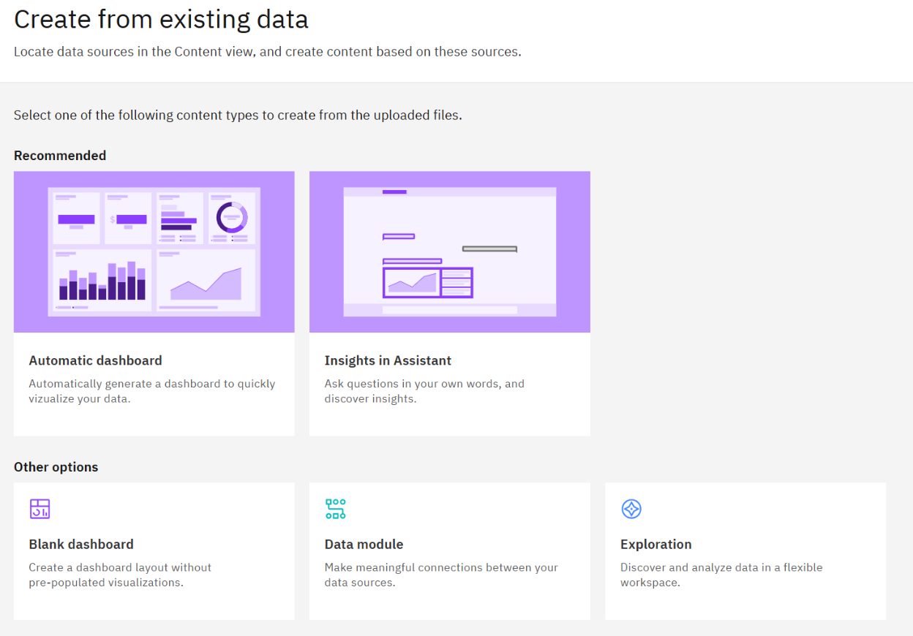
Turning Data into Actionable Insights
IBM Cognos converts raw sales & inventory data into insights
Addresses costly overstocks & stockouts in retail
Project dataset: Kaggle Warehouse & Retail Sales
“Create from Existing Data” function
AI auto-builds dashboard in seconds
Selects relevant charts, KPIs, and comparisons

Slide 9
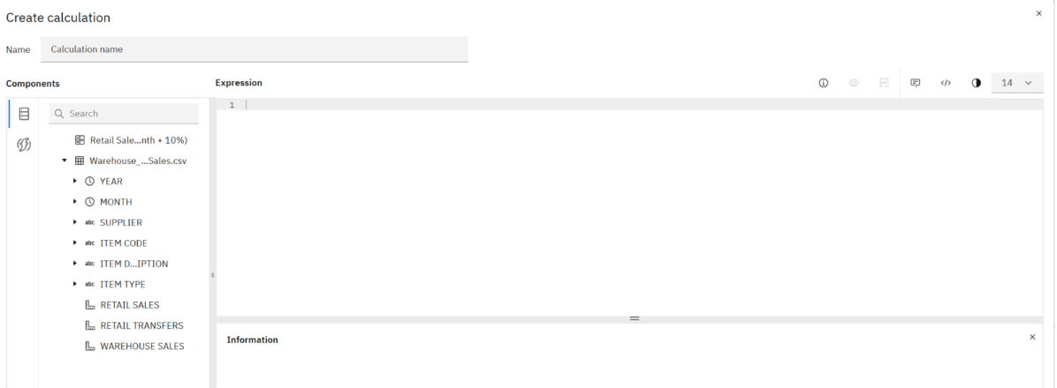
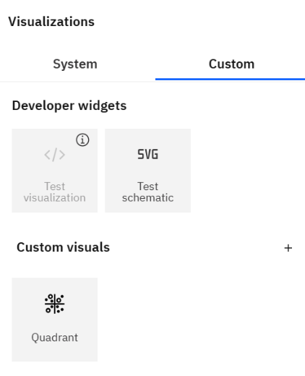
Customization & Advanced Personalization
Custom expressions & calculated fields
Create new measures, dimensions, KPIs
Scenario-specific filters
Example: show only items with >10% sales deviation from forecast
Flexible visualization formats
Bar, line, heat maps, KPI tiles, bubble charts, etc.

Slide 11
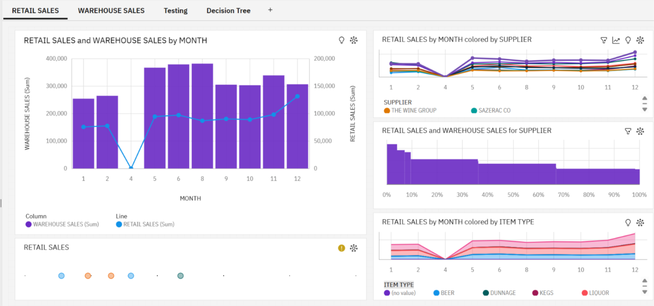
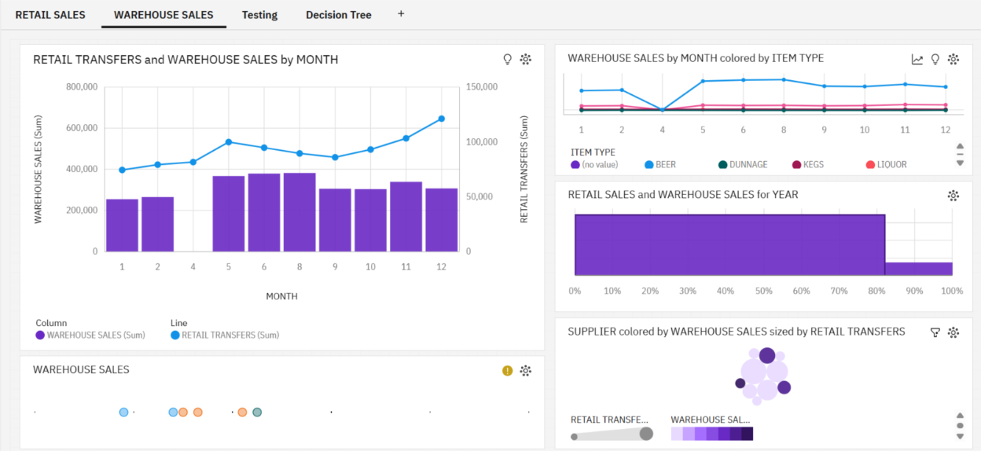
Forecasting & Insights
Forecast tool projects monthly sales trends
Identifies seasonal peaks & risk periods
Narrative Insights
AI-generated text summaries detect outliers & trends
Filters for “All Tabs” and “Current Tab”
Drill into specific suppliers, item types, time periods
Custom KPI charts
Compare warehouse transfers & retail sales over time

Slide 13
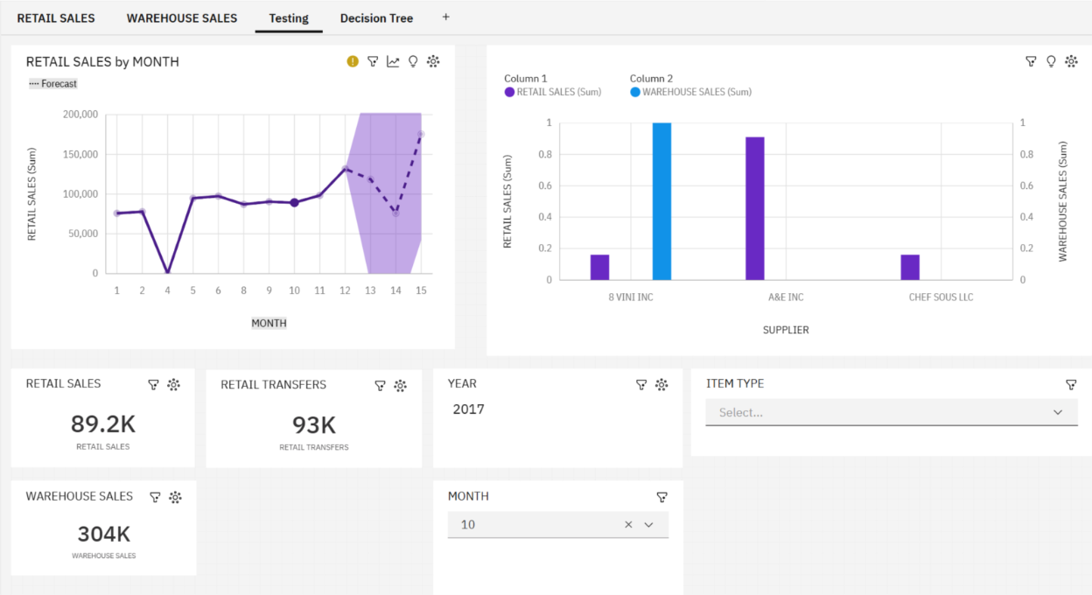
KPI Integration & Interactivity
KPIs track performance vs. forecast in real time
SMART: Specific, Measurable, Attributable, Realistic, Time-bound
Interactive dashboard elements
Filters, drop-down menus, drill-through navigation
Example: supplier filter to compare transfers vs. sales

Slide 15
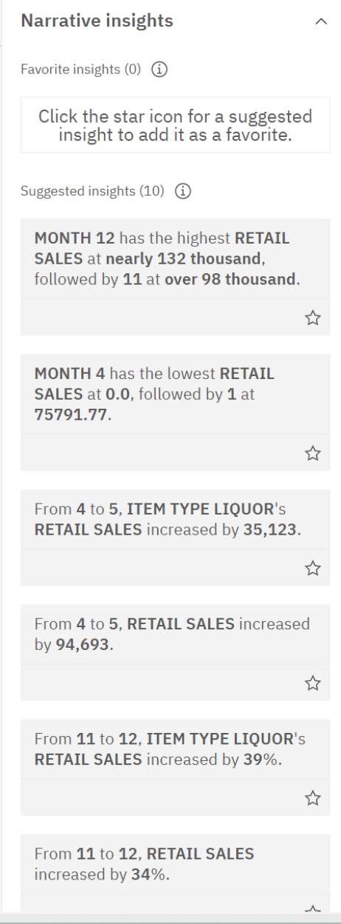
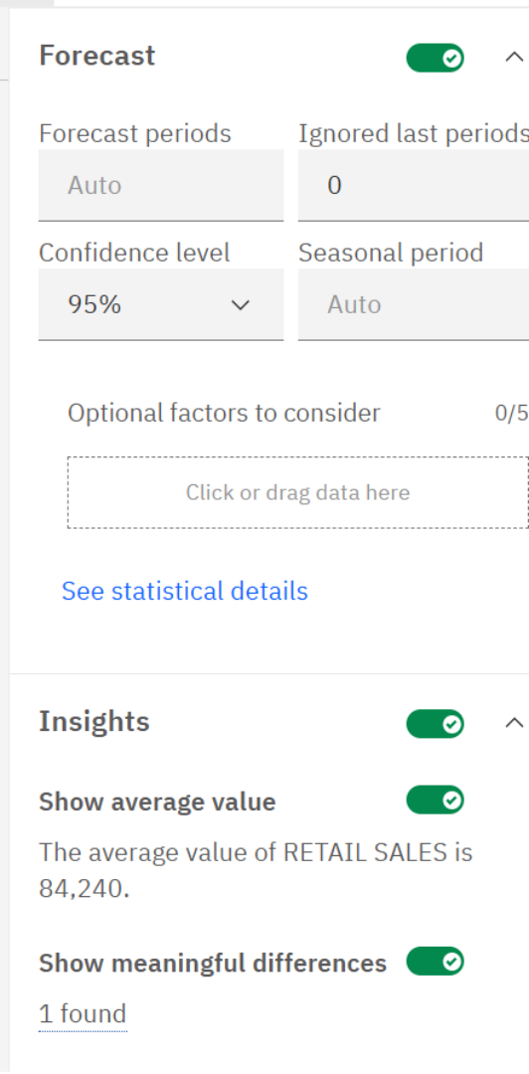
AI-Driven Narrative Insights
Automatically highlights key changes in data
Example: Month 8 highest warehouse sales (382K+)
Example: Beer category sales surge from Month 4 to 5
Flags anomalies early
Supports proactive adjustments in ordering & promotions
Saves time on manual interpretation

Slide 16
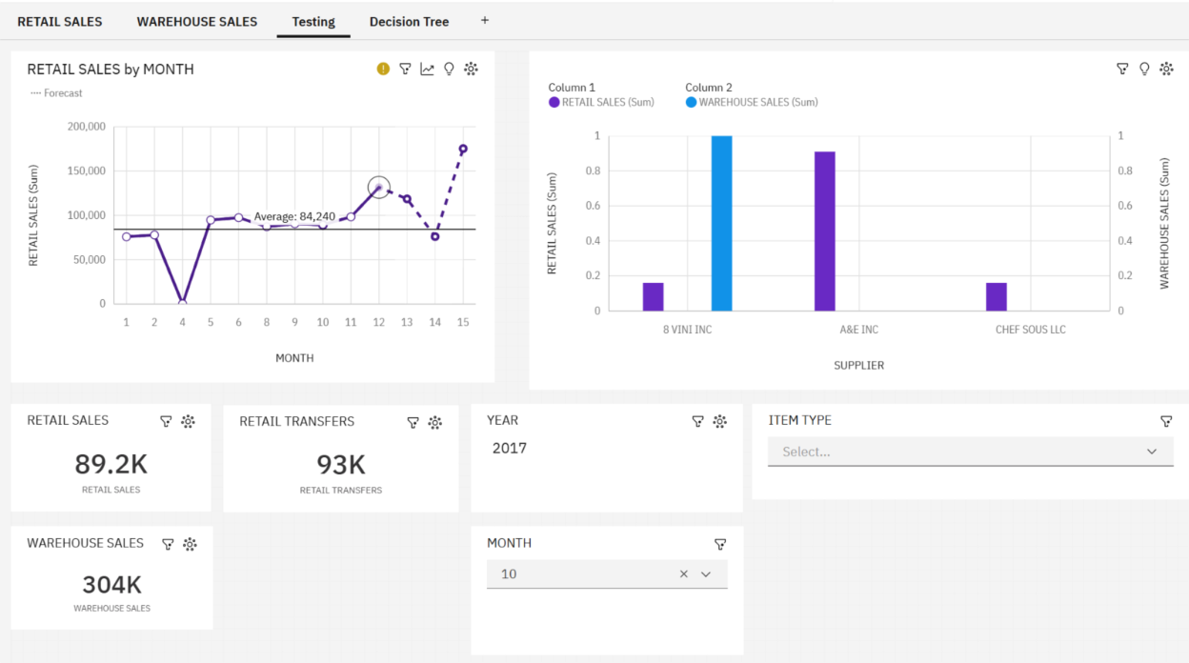
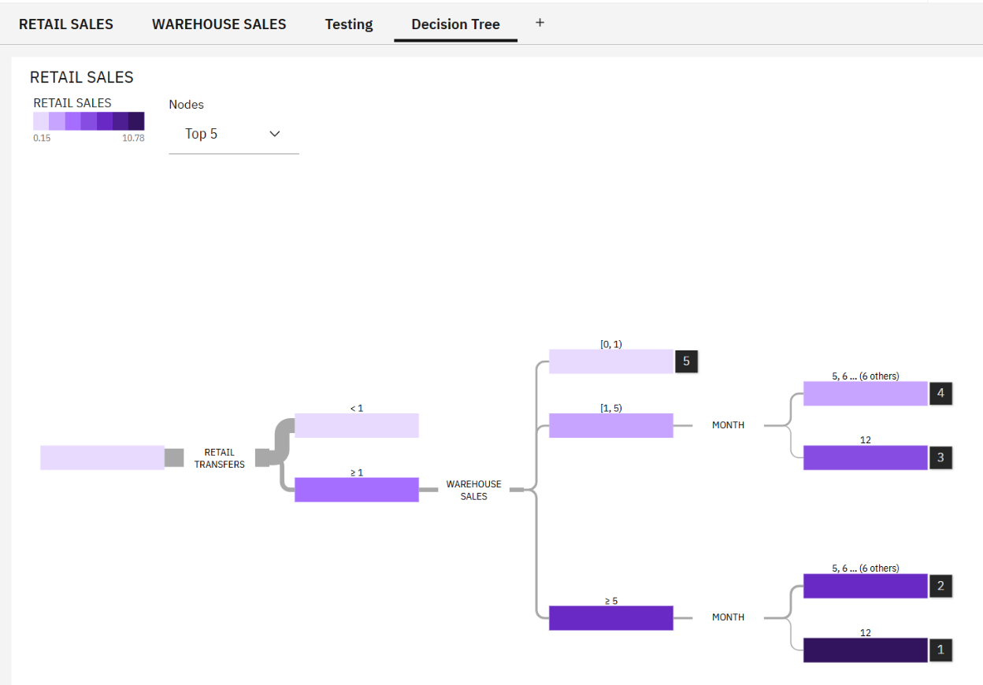
Decision Tree & Advanced Visuals
Dashboard monitored retail sales, warehouse transfers, supplier performance
AI-generated decision tree
Shows how transfers, warehouse sales, and months affect demand
Advanced visual options for deeper insight
Heat maps, sunburst diagrams, waterfall charts, radar charts, word clouds

Slide 17
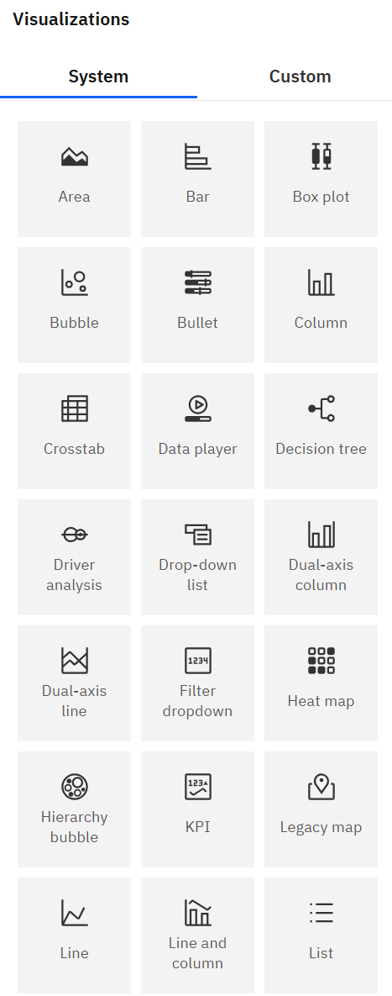
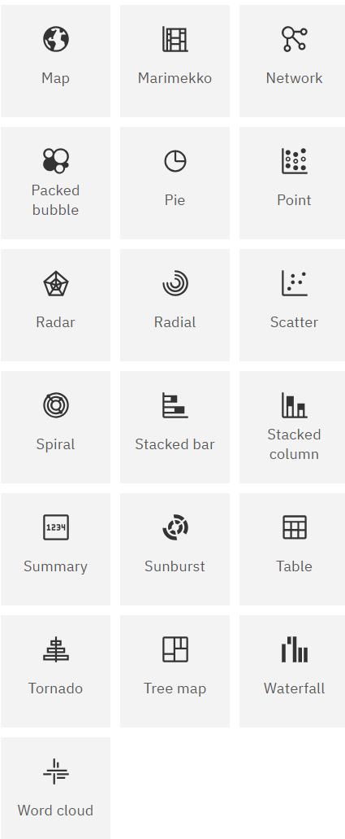

Slide 18
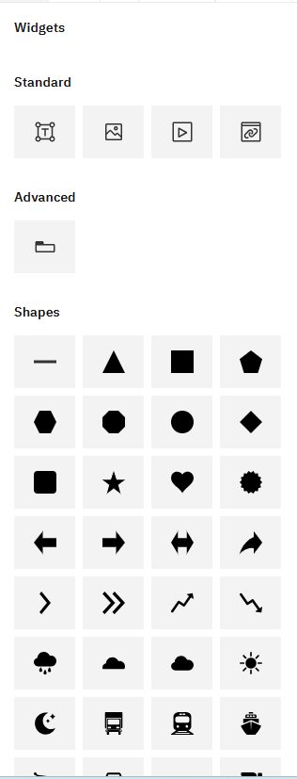
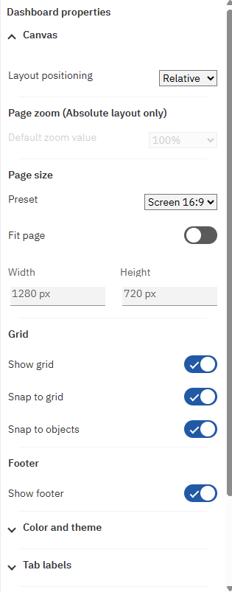
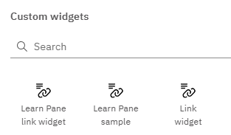
Widgets & Dashboard Properties
Regular widgets
Images, videos, text boxes, shapes, containers, advanced elements
Custom widgets
Specialized tools, external web content, unique visualizations
Properties panel
Page size, layout, alignment, themes, color schemes, tab labels

Slide 19

Data Integration & Connectivity
Integrates multiple data sources into one model
Warehouse, POS, supplier databases
Eliminates silos → improves forecasting accuracy
Calculated measures from multiple sources
Example: warehouse-to-retail ratio by supplier
Dynamic filters
Updates metrics instantly across all visuals

Slide 20

Experience & Customization Options
Focus on usability, simplicity, clarity
Critical for SMEs
Affordable, intuitive interface
63% say Cognos supports financial decisions
66% value data visualization (Magoma et al., 2021)
Custom layouts & themes
Interactive filters, synchronized across visuals
Calculated fields for dynamic updates

Slide 21
Summary of Features
IBM Cognos = dynamic decision-support system
Combines forecasting, AI insights, multiple visualization formats
Enables timely, confident decisions
Reduces forecasting errors & optimizes inventory

Slide 22
Competitive Landscape, Strengths, Case Studies, and Recommendations

Slide 23
Competitive Landscape
Competitors: Power BI, Tableau, Qlik Sense, SAP Analytics Cloud, Looker
Cognos strengths: AI-driven insights, scalability, governance
Each tool has unique strengths & limitations

Slide 24
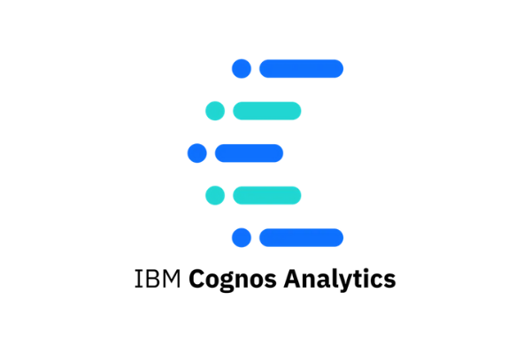



Feature Comparison Highlights
Cognos: Built-in AI Assistant, advanced forecasting, 100+ data connectors, enterprise security
Power BI: Low cost, Microsoft ecosystem
Tableau: Visualization & storytelling leader
Qlik Sense: Associative data model, predictive modeling

Slide 25
Strengths of Cognos
AI insights for non-technical users (e.g., hospital network queries)
Scalability: suitable for SMEs & global enterprises
Flexible deployment: cloud, on-prem, hybrid
Strong security & compliance features

Slide 26
Weaknesses of Cognos
Higher starting cost than Power BI
Less visual creativity than Tableau
Smaller community than Microsoft tools

Slide 27
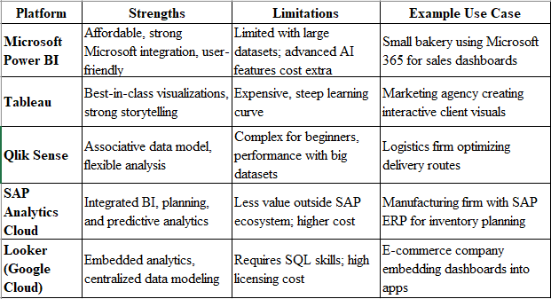

Slide 28

Case Study 1 – European Supermarket Chain
Challenge: Forecasting demand accurately
Solution: Integrated POS & warehouse data with ML
Result: 33% error reduction, €170M annual savings

Slide 29
Case Study 2 – Global Manufacturing Company
Challenge: Data scattered across 20 ERP systems
Solution: Centralized reporting hub with Cognos
Result: Reporting time cut from 2 weeks to 2 days; downtime reduced by 15%

Slide 30
Case Study 3 – Local Retail Store Chain
Challenge: No real-time inventory insight
Solution: Dashboards for daily sales & inventory
Result: 8% profit increase in 3 months

Slide 31
Recommendations
Start
Start small, scale later
Use
Use correct license per role
Integrate
Integrate all key data sources
Train
Train staff on AI insights

Slide 32
Conclusion
Cognos: More than BI—predictive & governance tool
Ideal for compliance-heavy industries
Strategic choice despite higher cost

Slide 33
Thank you
Bi Solution Report
Sharon, Selena, Charmy & Lekhya
ISM6255

